Slide 1
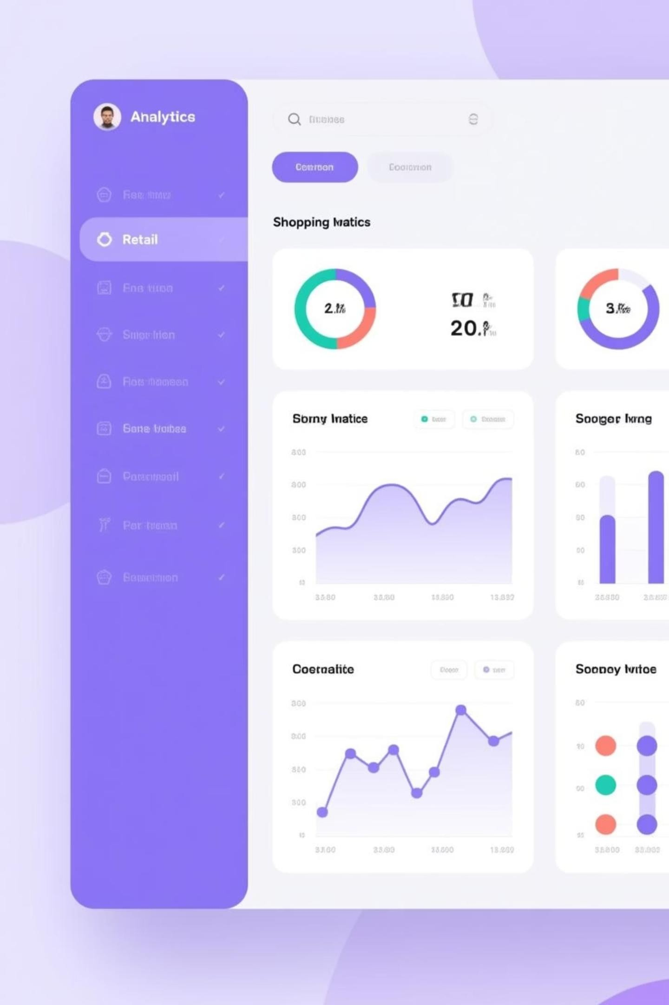
Customer Shopping Behavior Analysis
Uncovering insights from 3,900 purchases to guide strategic business decisions
~By Ayush Gupta

Slide 2

Project Overview
This comprehensive analysis examines customer shopping behavior using transactional data from 3,900 purchases across various product categories.
Our goal: uncover insights into spending patterns, customer segments, product preferences, and subscription behavior to drive strategic business decisions.

Slide 3
Dataset at a Glance
3,900
Total Purchases
Transactions analyzed
18
Data Columns
Feature dimensions
37
Missing Values
In Review Rating only
Demographics
Age, Gender, Location, Subscription Status
Purchase Details
Item, Category, Amount, Season, Size, Color
Shopping Behavior
Discounts, Promo Codes, Purchase History, Reviews, Shipping

Slide 4
Data Preparation with Python
01
Data Loading & Exploration
Imported dataset using pandas, analyzed structure with df.info() and summary statistics
03
Column Standardization
Renamed columns to snake_case for better readability and
documentation
05
Data Consistency
Verified redundancy between discount_applied and promo_code_used, dropped duplicate
02
Missing Data Handling
Imputed missing Review Rating values using median rating per product category
04
Feature Engineering
Created age_group and purchase_frequency_days columns for
deeper analysis
06
Database Integration
Integrated cleaned customer shopping dataset into SQL Server and performed advanced analytical queries for business insights.

Slide 5
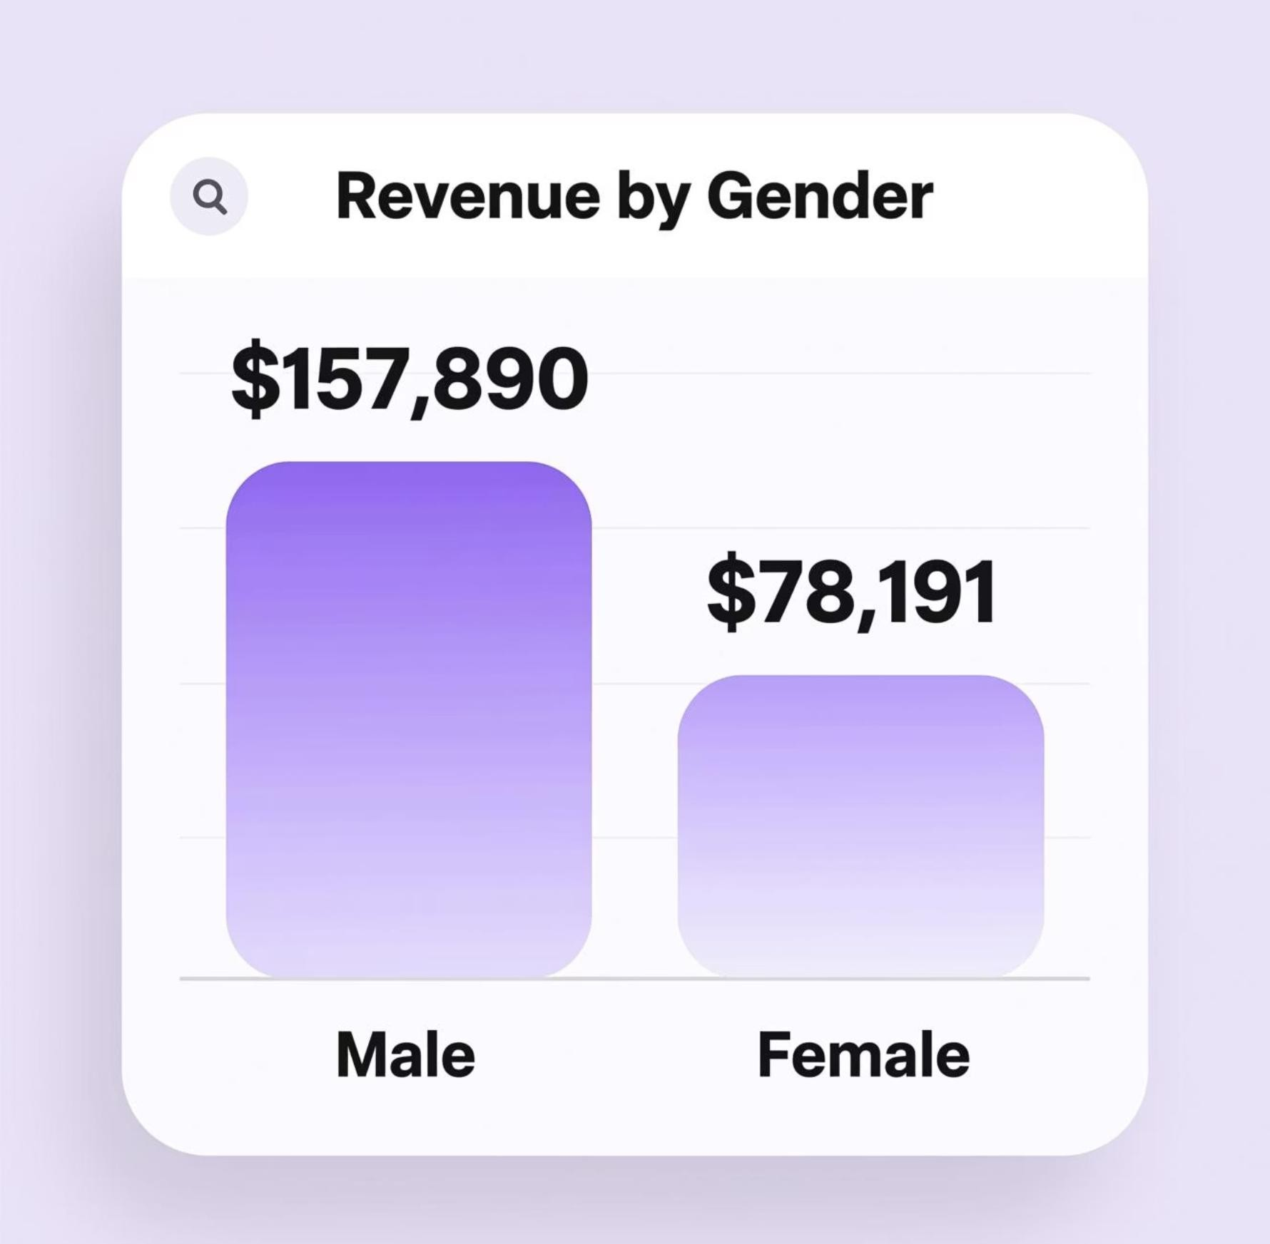
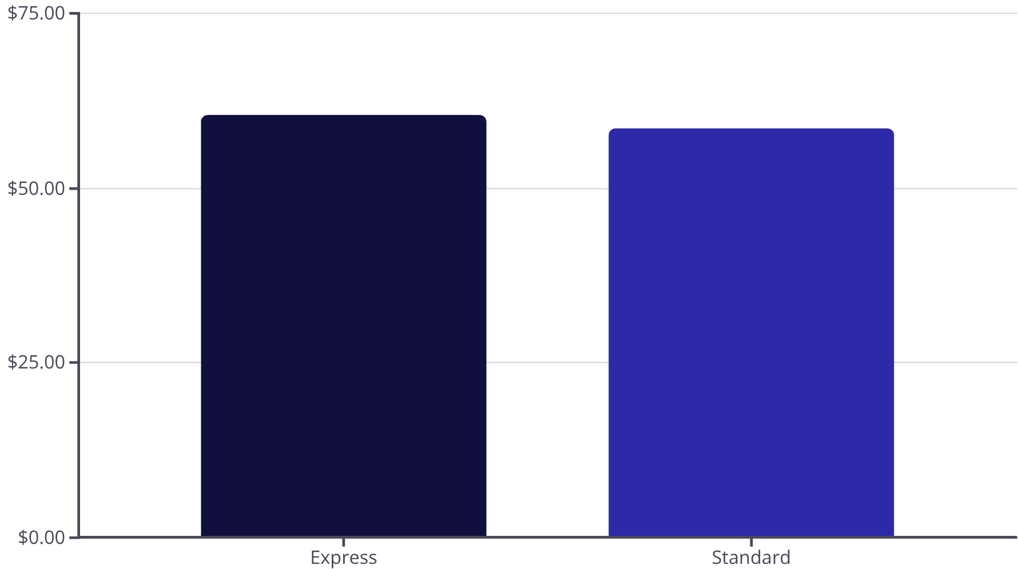
Revenue Insights
Revenue by Gender
Male customers generated $157,890 in total revenue compared to $78,191 from female customers.
Shipping Type Impact
Express shipping customers spend an average of $60.48 versus $58.46 for Standard shipping. Higher-value customers prefer faster delivery options.

Slide 6
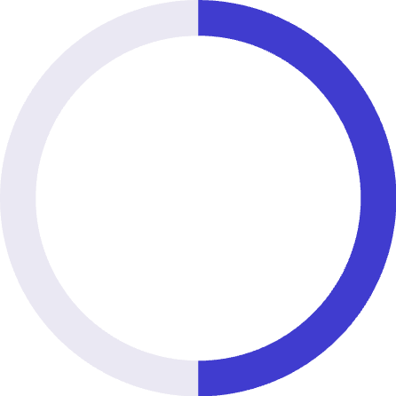
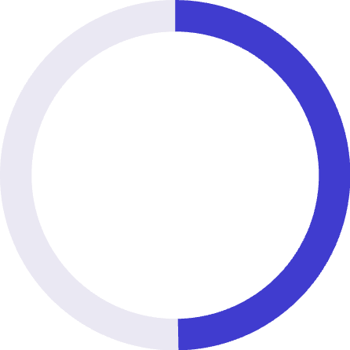
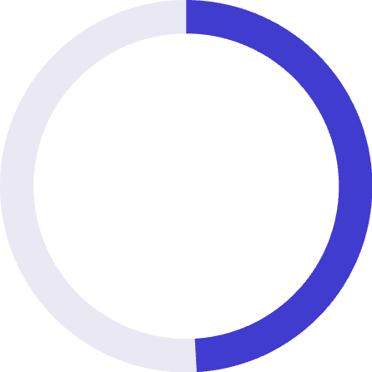
Product Performance Analysis
Top 5 Products by Rating
Discount-Dependent Products
Products with the highest percentage of discounted purchases:
1
Gloves
3.86 average rating
50%
2
Sandals
3.84 average rating
Hat
3
Boots
3.82 average rating
49.7%
4
Hat
3.80 average rating
Sneakers
5
Skirt
3.78 average rating
49.1%
Coat

Slide 7



Customer Segmentation
New Customers
83 customers
1
Returning Customers
701 customers
2
Loyal Customers
3,116 customers
3
Customer classification based on purchase history reveals a strong loyal customer base representing 80% of total customers.
Subscription Analysis
Subscribers: 1,053 customers with $59.49 average spend
Repeat Buyer Behavior
Among customers with >5 purchases:
Non-subscribers: 2,847 customers with $59.87 average spend
958 are subscribers
2,518 are non-subscribers

Slide 8
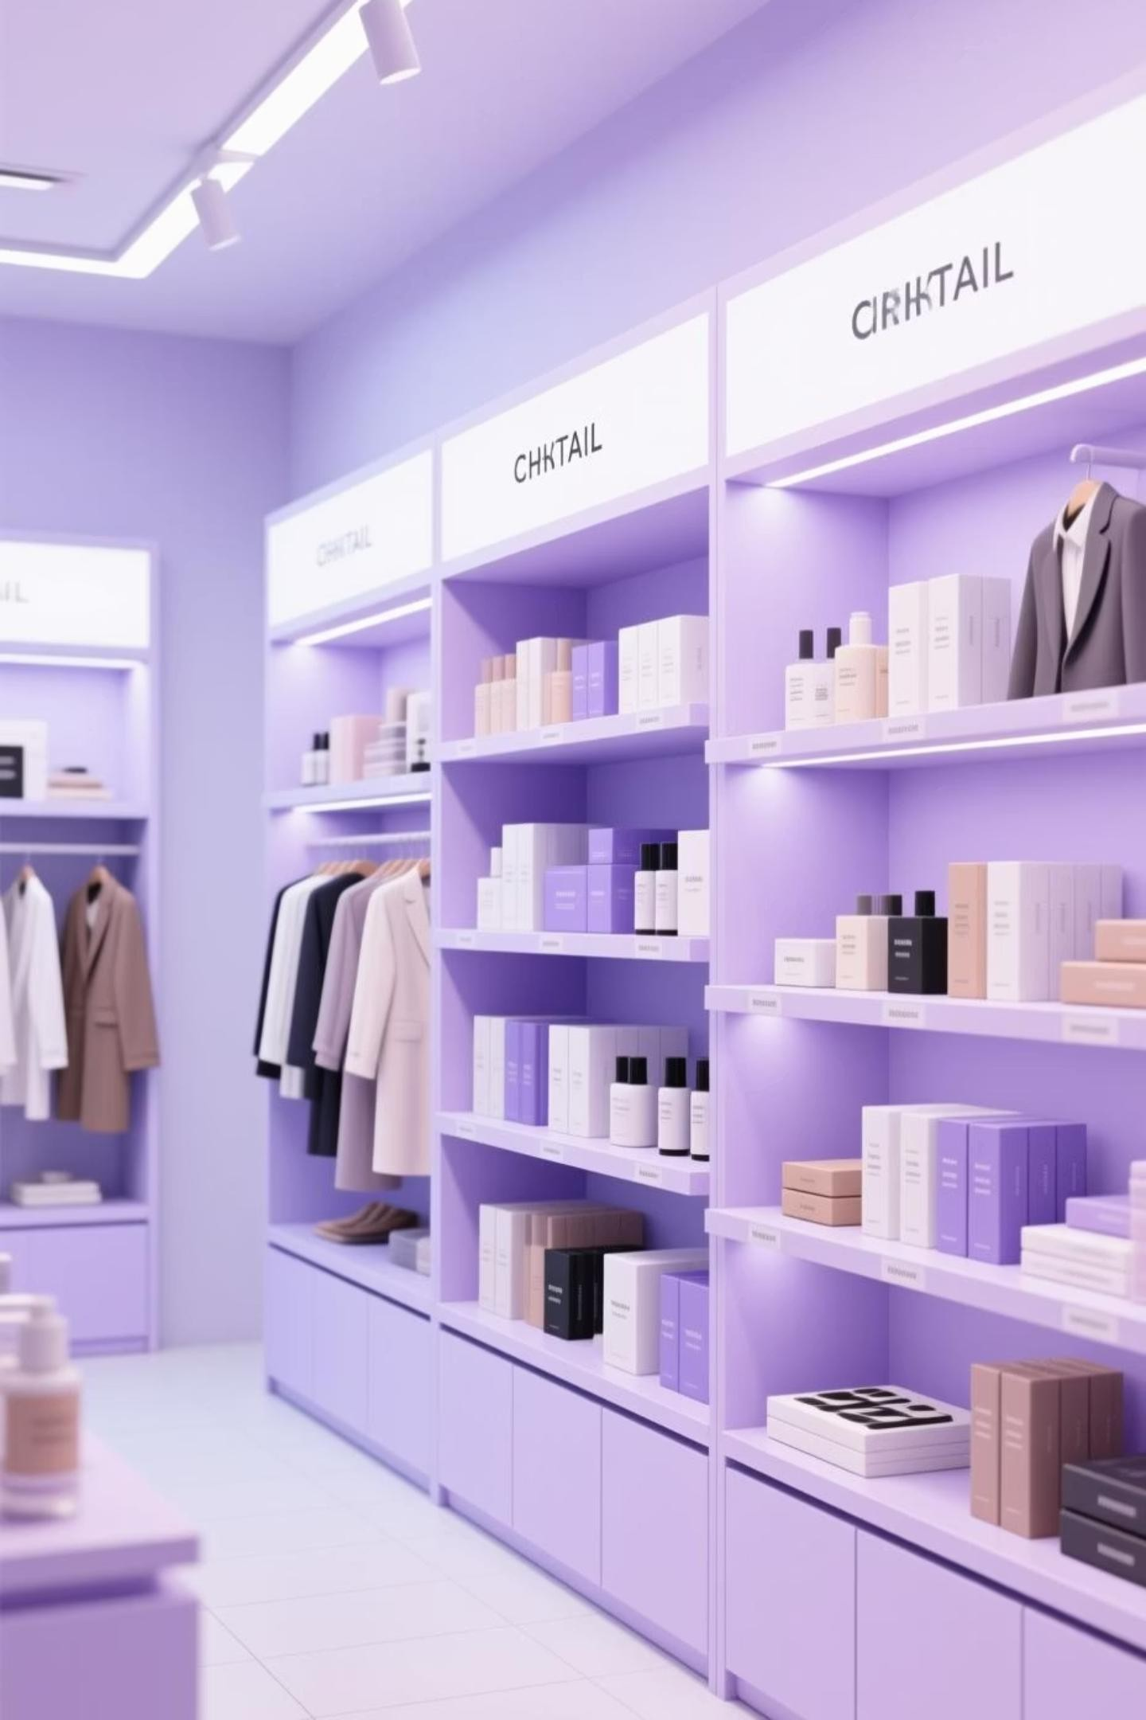
Top Products by Category
1
Accessories
Jewelry leads with 171 orders, followed by Sunglasses and Belt (161 each)
2
Clothing
Blouse and Pants tie at 171 orders, with Shirt close behind at 169 orders
3
Footwear
Sandals top the category with 160 orders, followed by Shoes (150) and
Sneakers (145)
4
Outerwear
Jacket leads with 163 orders, followed closely by Coat at 161 orders

Slide 9
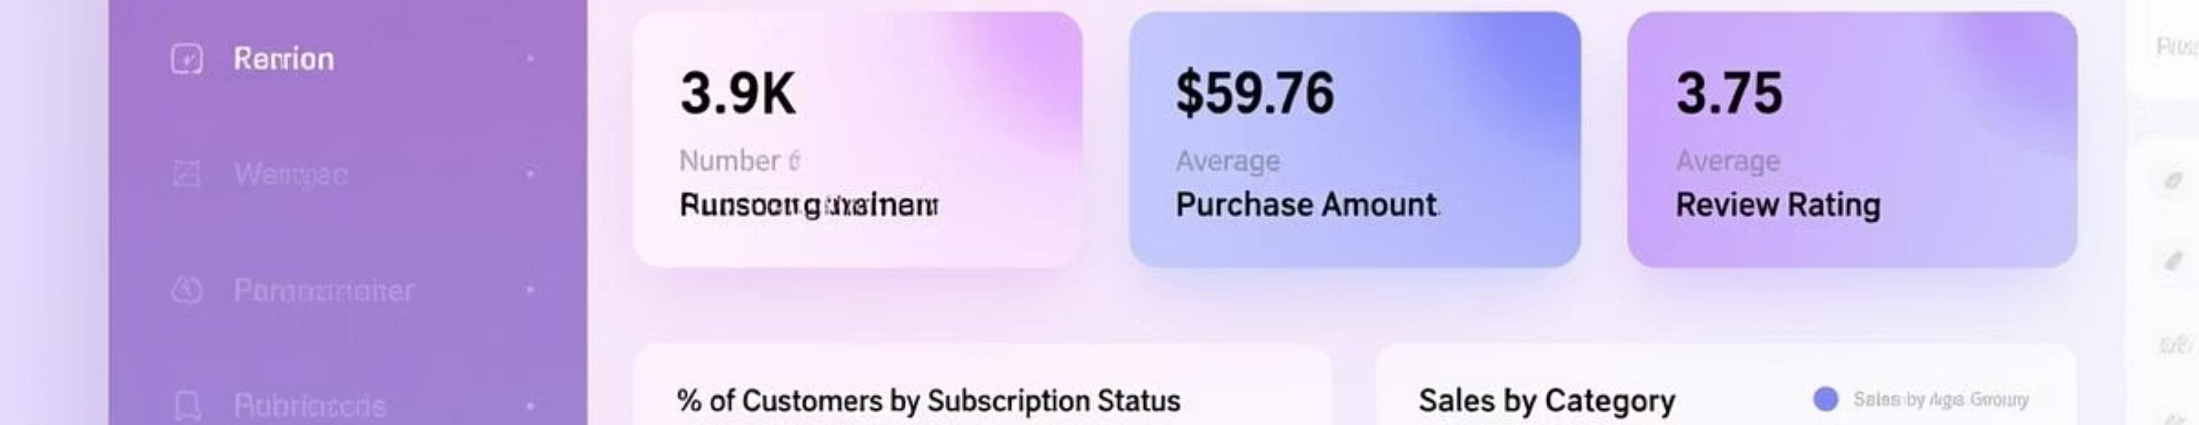


Interactive Power BI Dashboard
We built a comprehensive interactive dashboard in Power BI to visualize key insights and enable data-driven decision making.
Real-Time Insights
Dynamic visualizations of customer behavior and sales trends
Interactive Filters
Drill down by category, demographics, and time periods
KPI Tracking
Monitor key performance indicators and business metrics

Slide 10






Business Recommendations
Boost Subscriptions
Promote exclusive benefits and perks for subscribers to increase conversion from non- subscribers
Customer Loyalty Programs
Reward repeat buyers to move them into the "Loyal" segment and increase lifetime value
Review Discount Policy
Balance sales boosts with margin control, especially for discount-dependent products
Product Positioning
Highlight top-rated and best-selling products in marketing campaigns
Targeted Marketing
Focus efforts on high-revenue age groups and express-shipping users

Slide 11
Thank You!
We appreciate your time and attention today. We're happy to answer any questions you may have regarding our analysis and recommendations.

